Slide 1



CryptoCurrency
Does the Bitcoin leads everything?
Juwon Lee, Economics and Statistics, Yonsei University

Slide 2
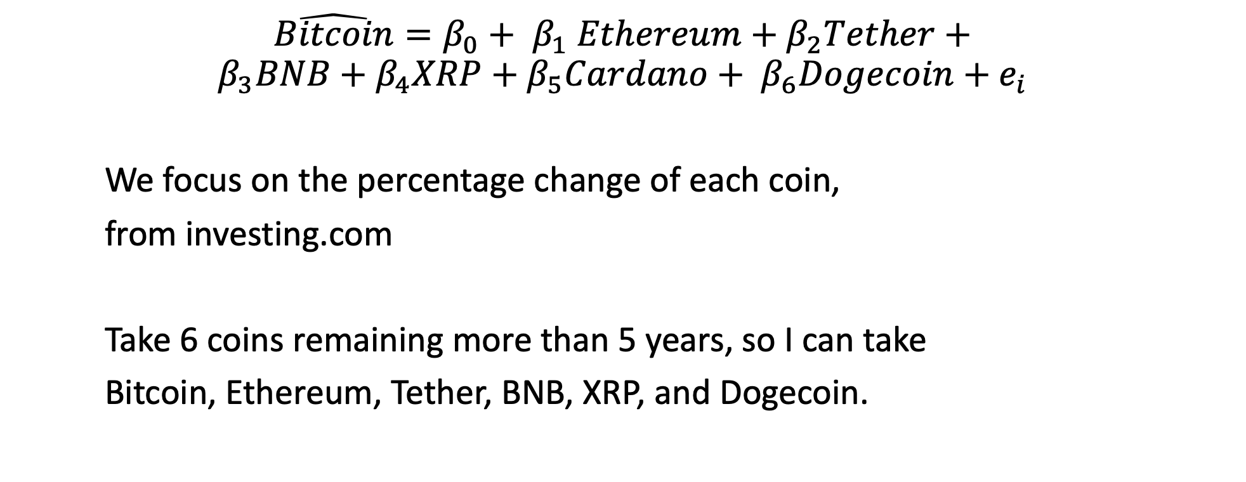
The model setting
$$\hat{Bitcoin}=β_{0}+ β_{1} Ethereum+β_{2}Tether+$$
$$β_{3}BNB+β_{4}XRP+β_{5}Cardano+ β_{6}Dogecoin+e_{i}$$
We focus on the percentage change of each coin,
from investing.com
Take 6 coins remaining more than 5 years, so I can take
Bitcoin, Ethereum, Tether, BNB, XRP, and Dogecoin.

Slide 3
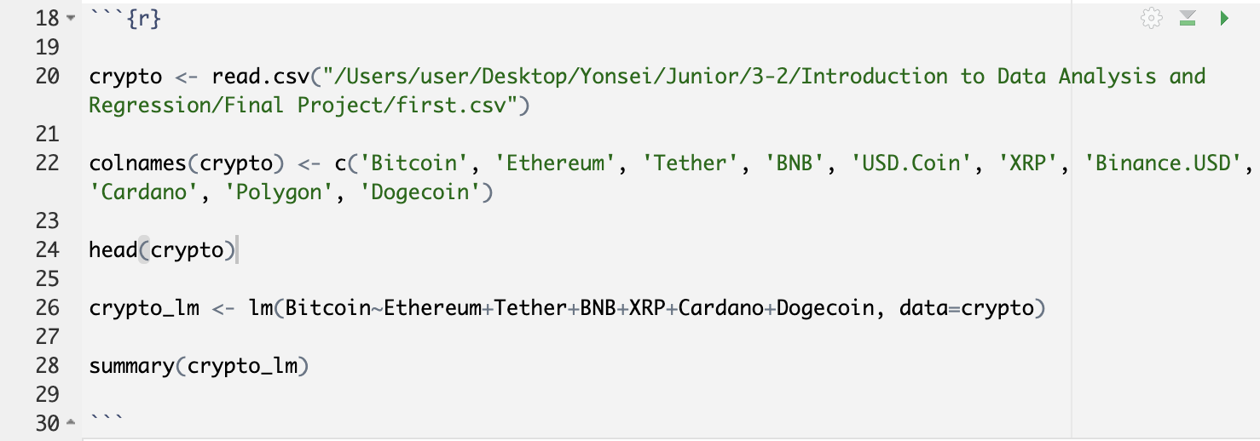
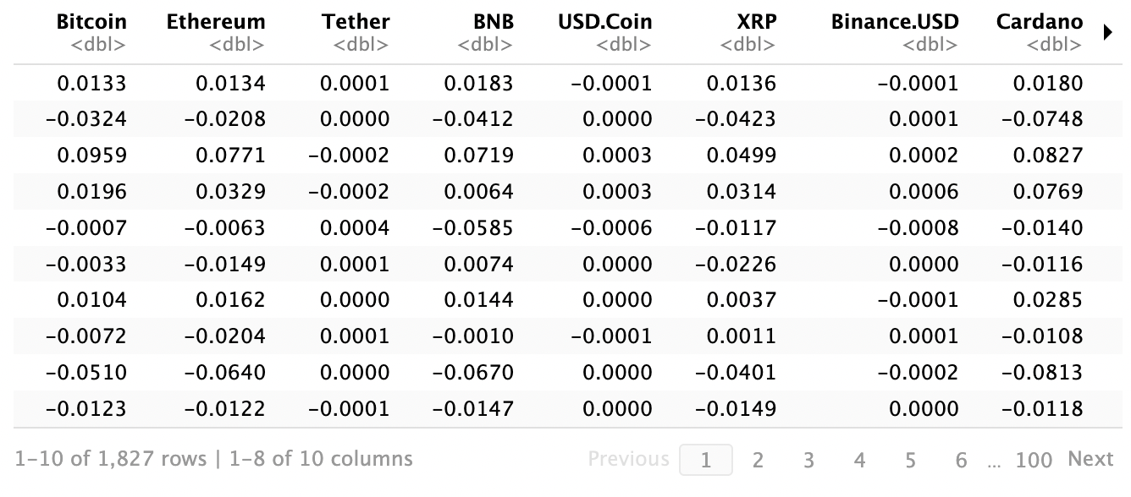
** USD.Coin,
Binance.USD,
Polygon don’t remain
for five years,
so we decide to eliminate
these variables.

Slide 4
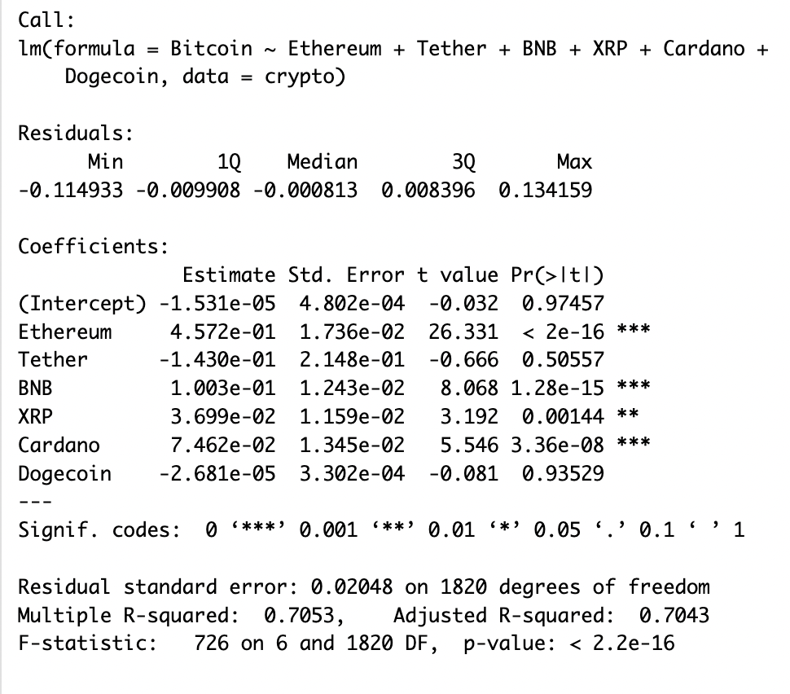
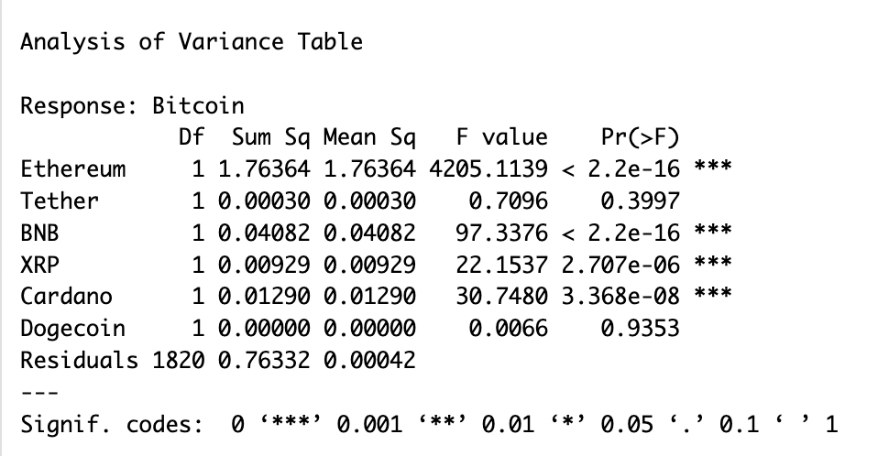

Slide 5
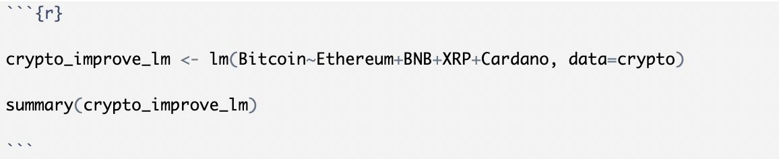
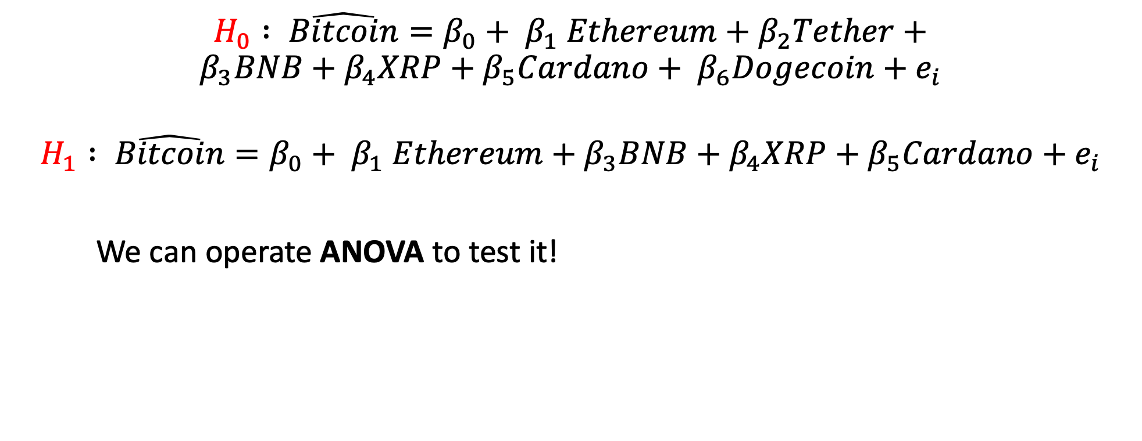
Improved model
$$H_{0} : \hat{Bitcoin}=β_{0}+ β_{1} Ethereum+β_{2}Tether+$$
$$β_{3}BNB+β_{4}XRP+β_{5}Cardano+ β_{6}Dogecoin+e_{i}$$
$$H_{1} : \hat{Bitcoin}=β_{0}+ β_{1} Ethereum+β_{3}BNB+β_{4}XRP+β_{5}Cardano+e_{i}$$
We can operate ANOVA to test it!

Slide 6
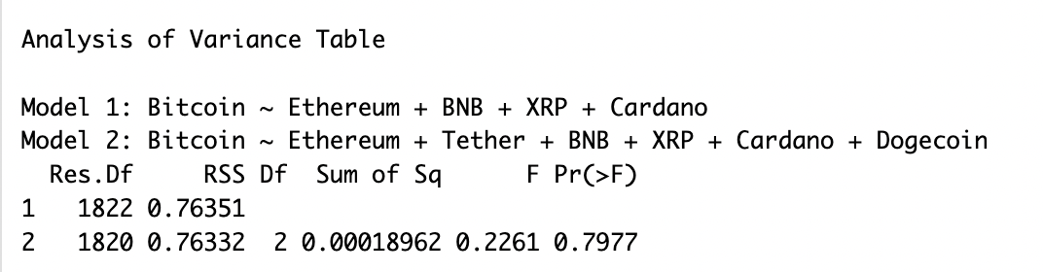
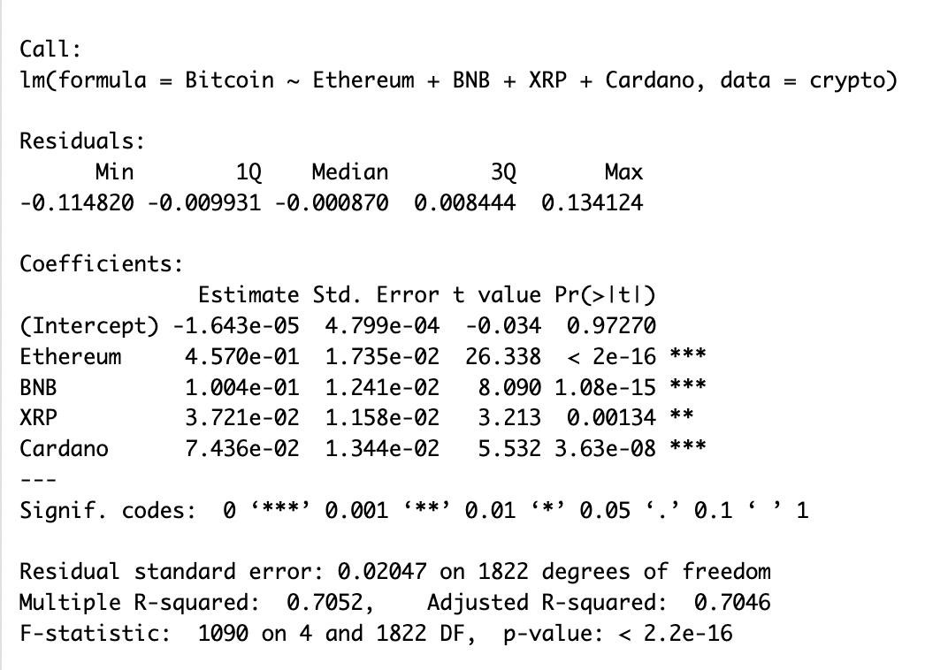

Slide 7
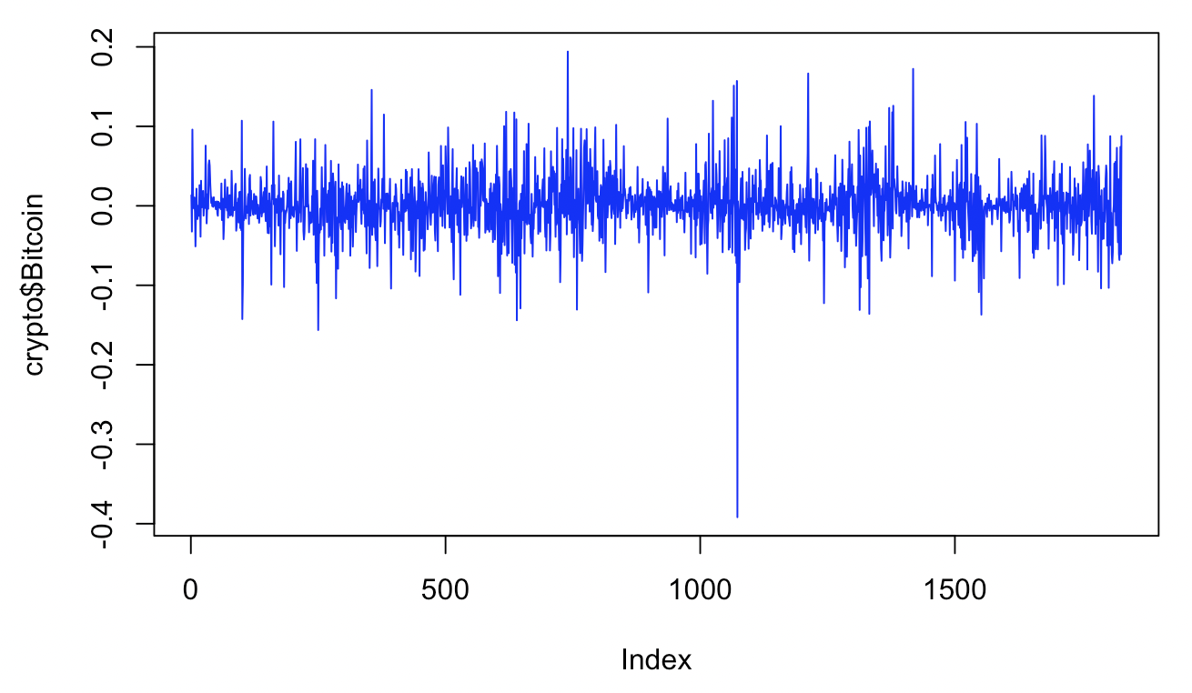
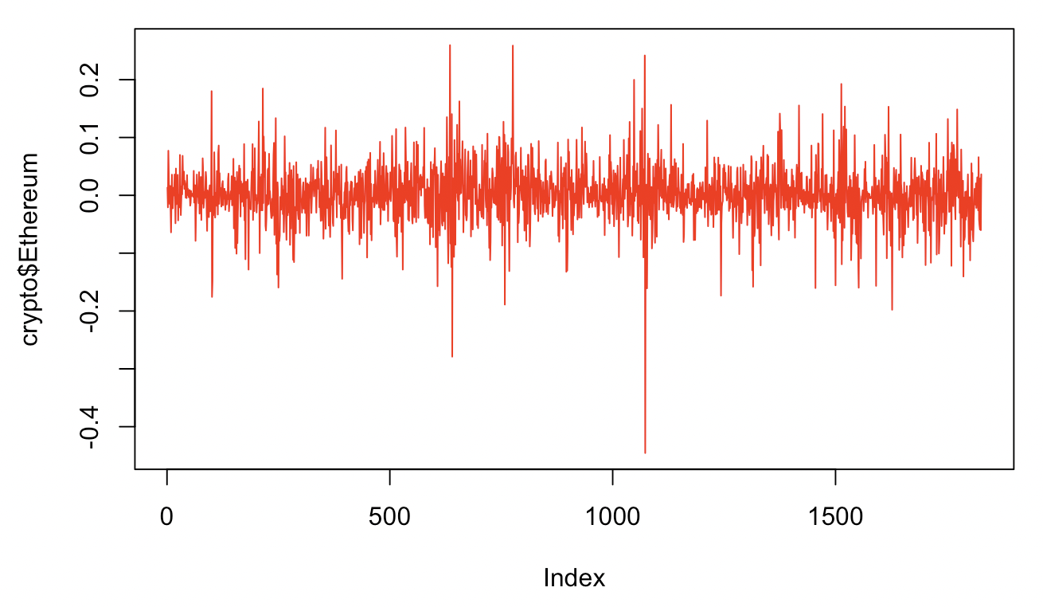
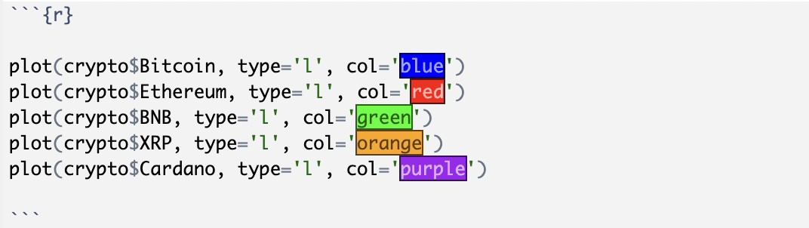
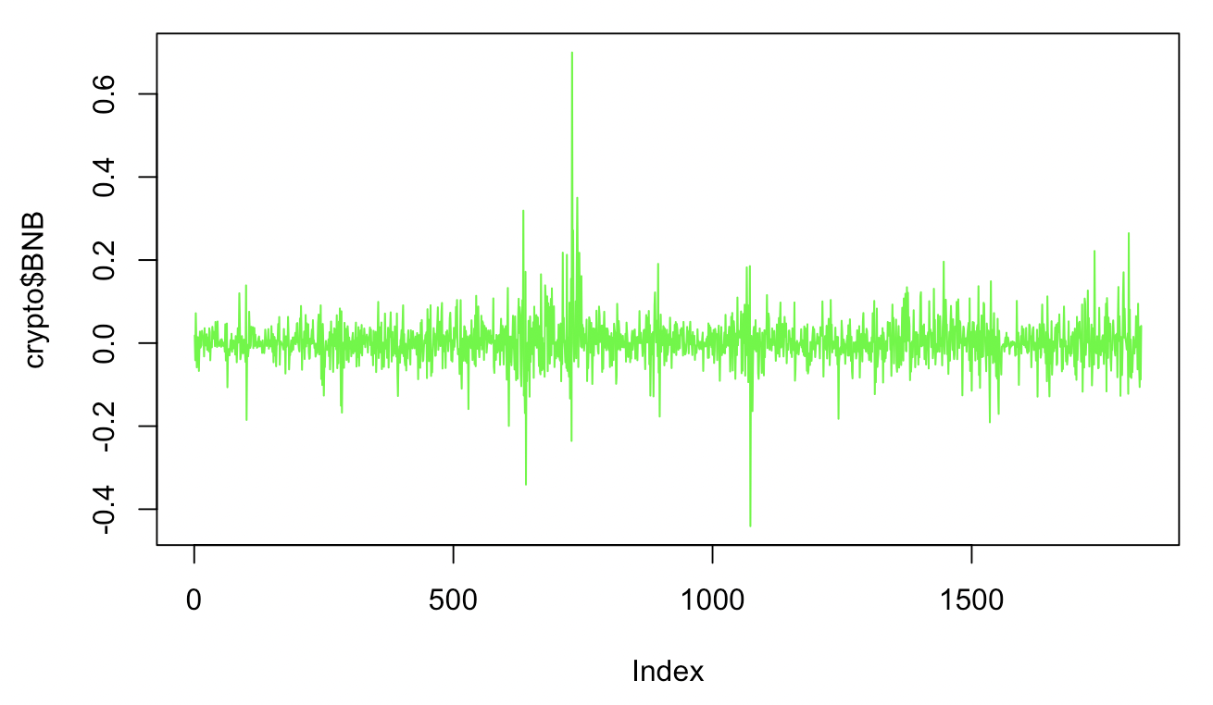
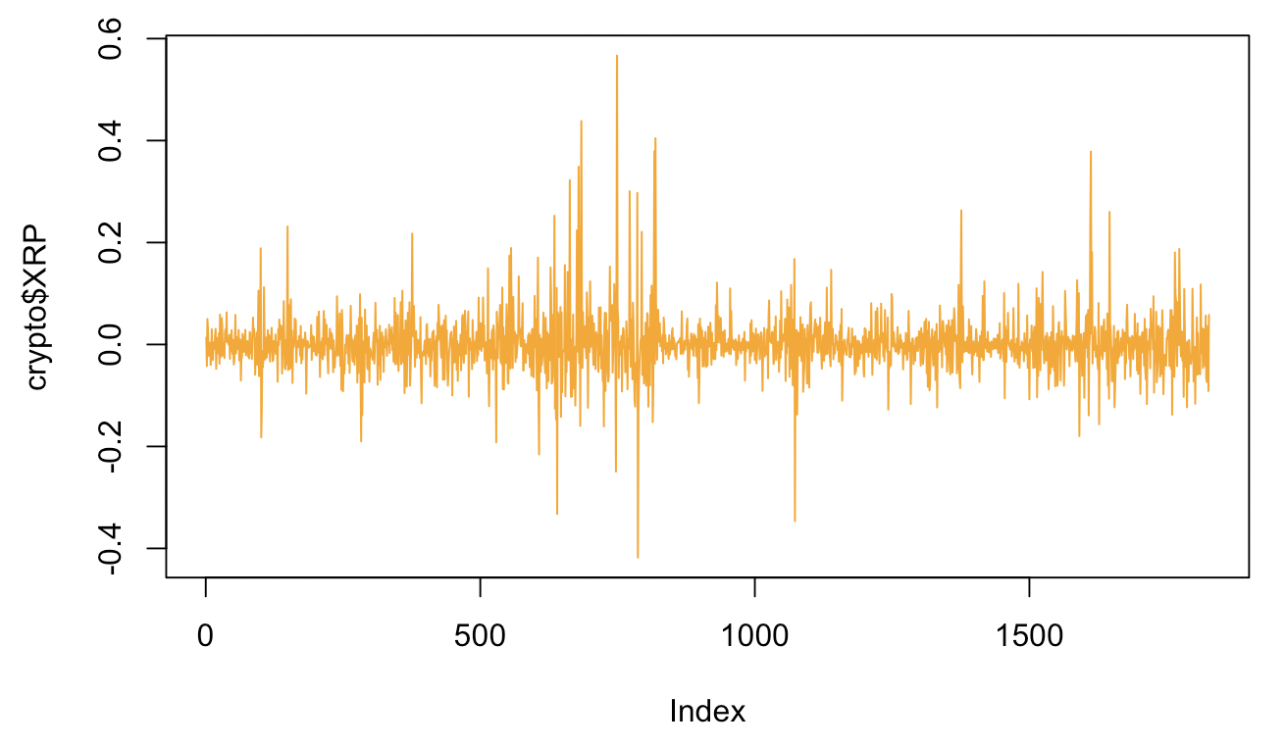
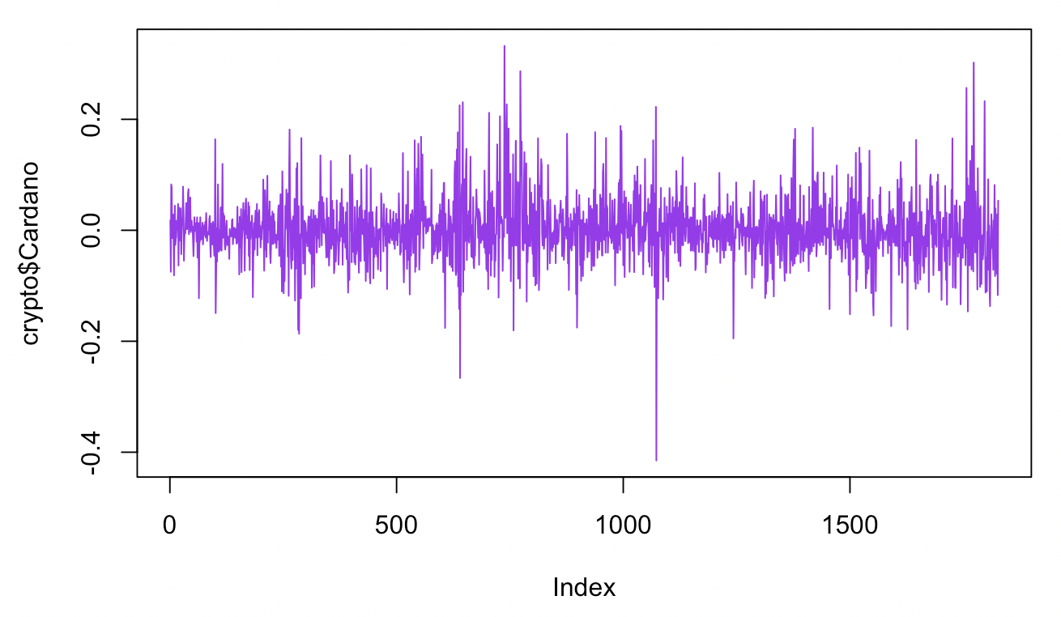
Appendix – Graphical Explanation

Slide 8
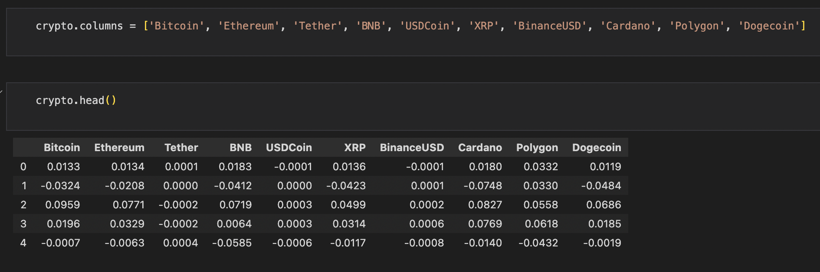
Appendix – Python

Slide 9
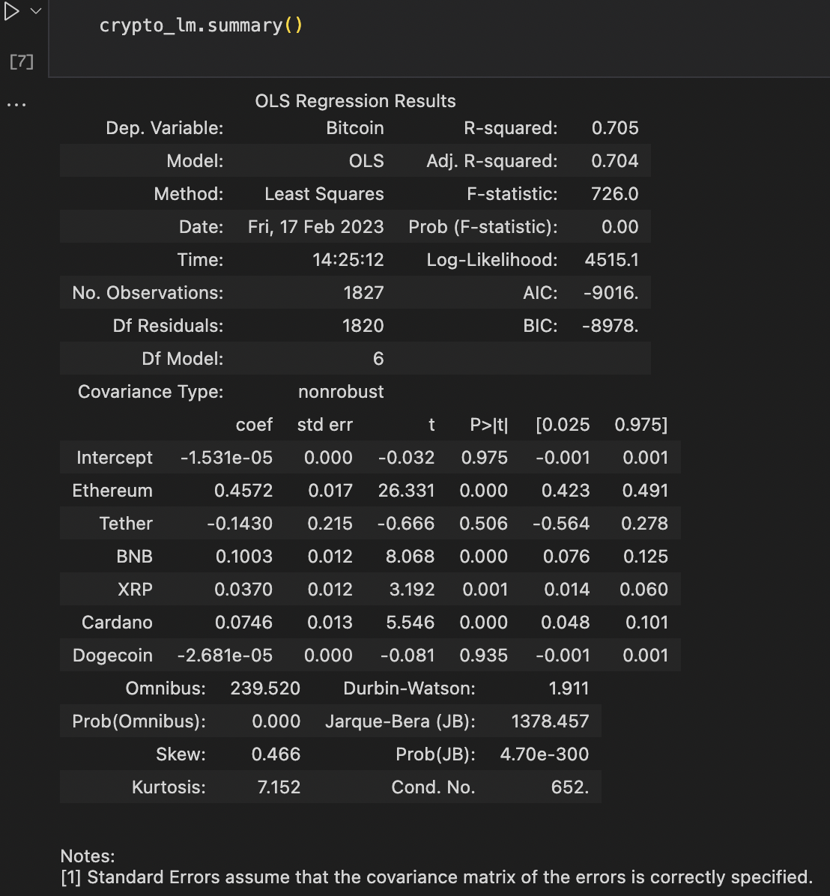
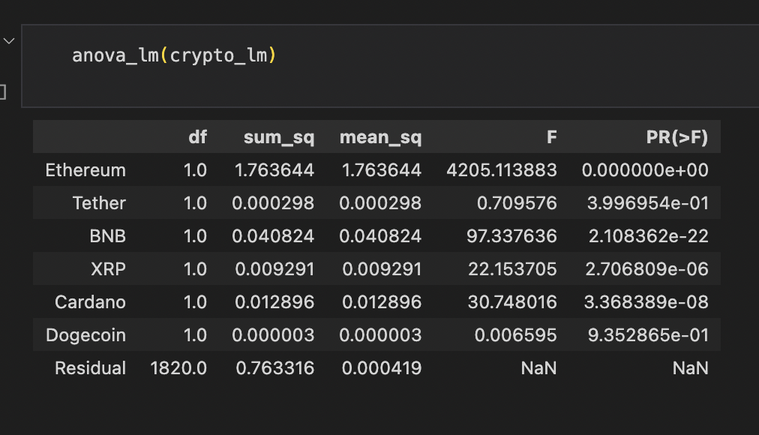

Slide 10
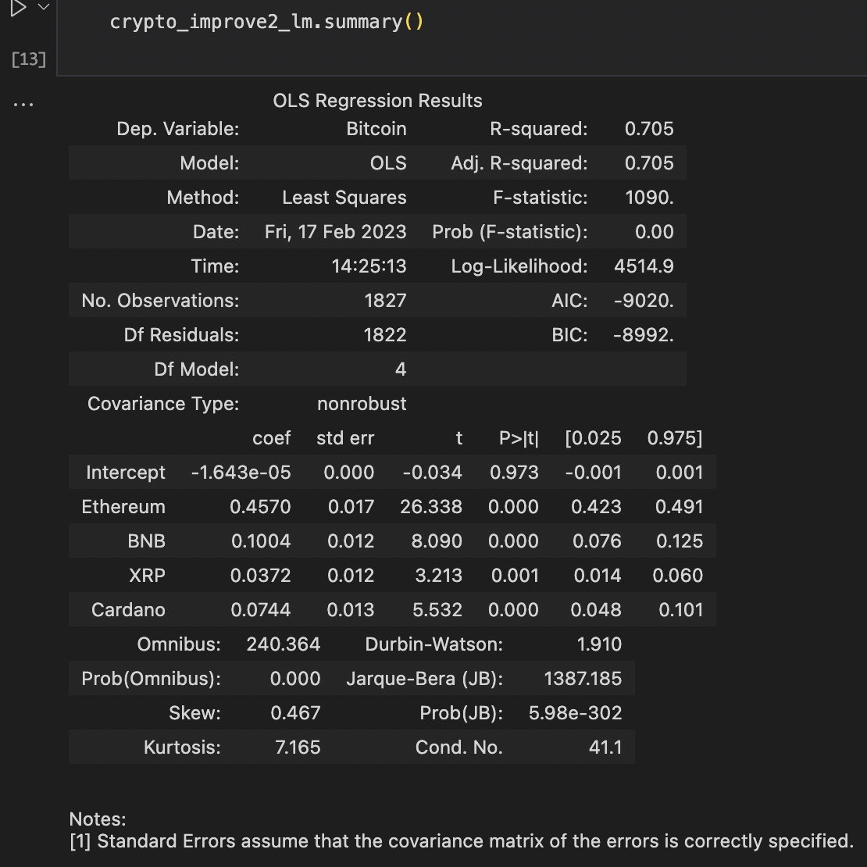
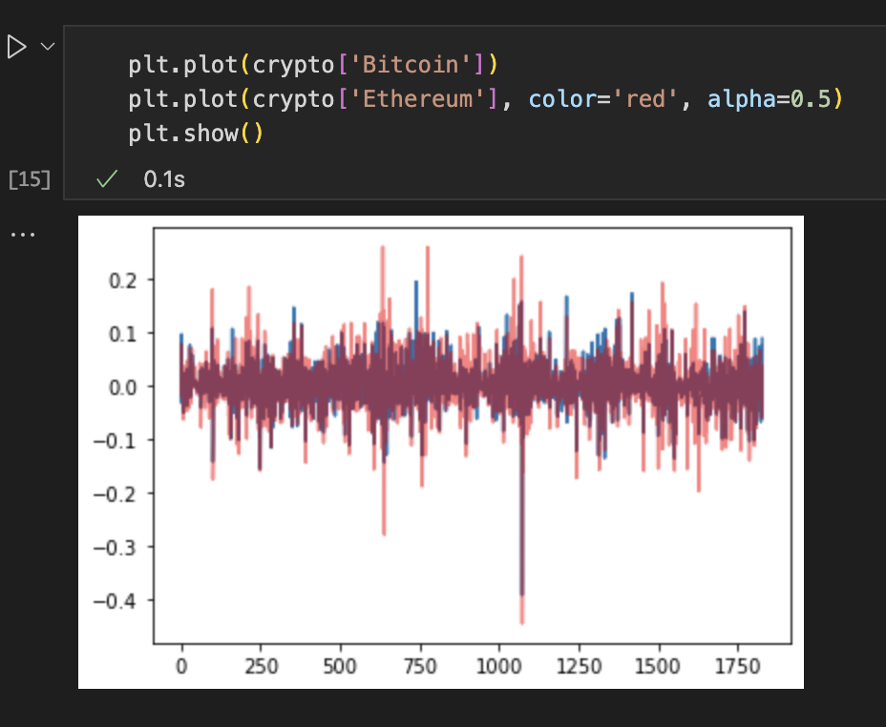

Slide 11
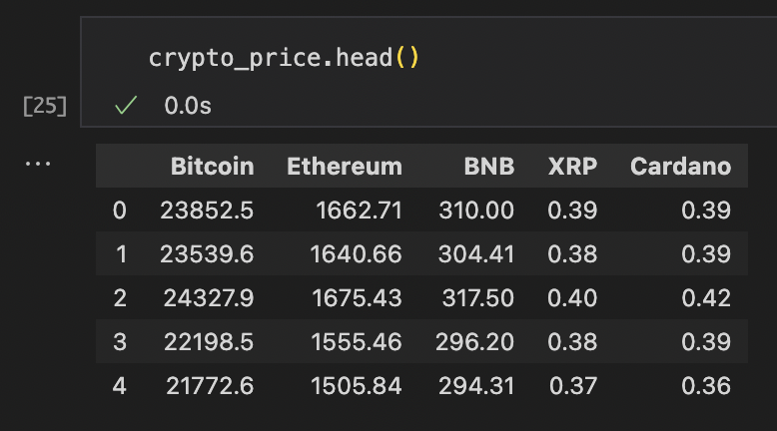
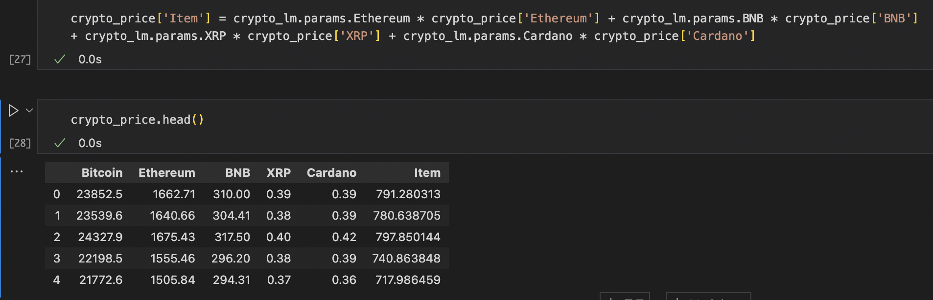

Slide 12
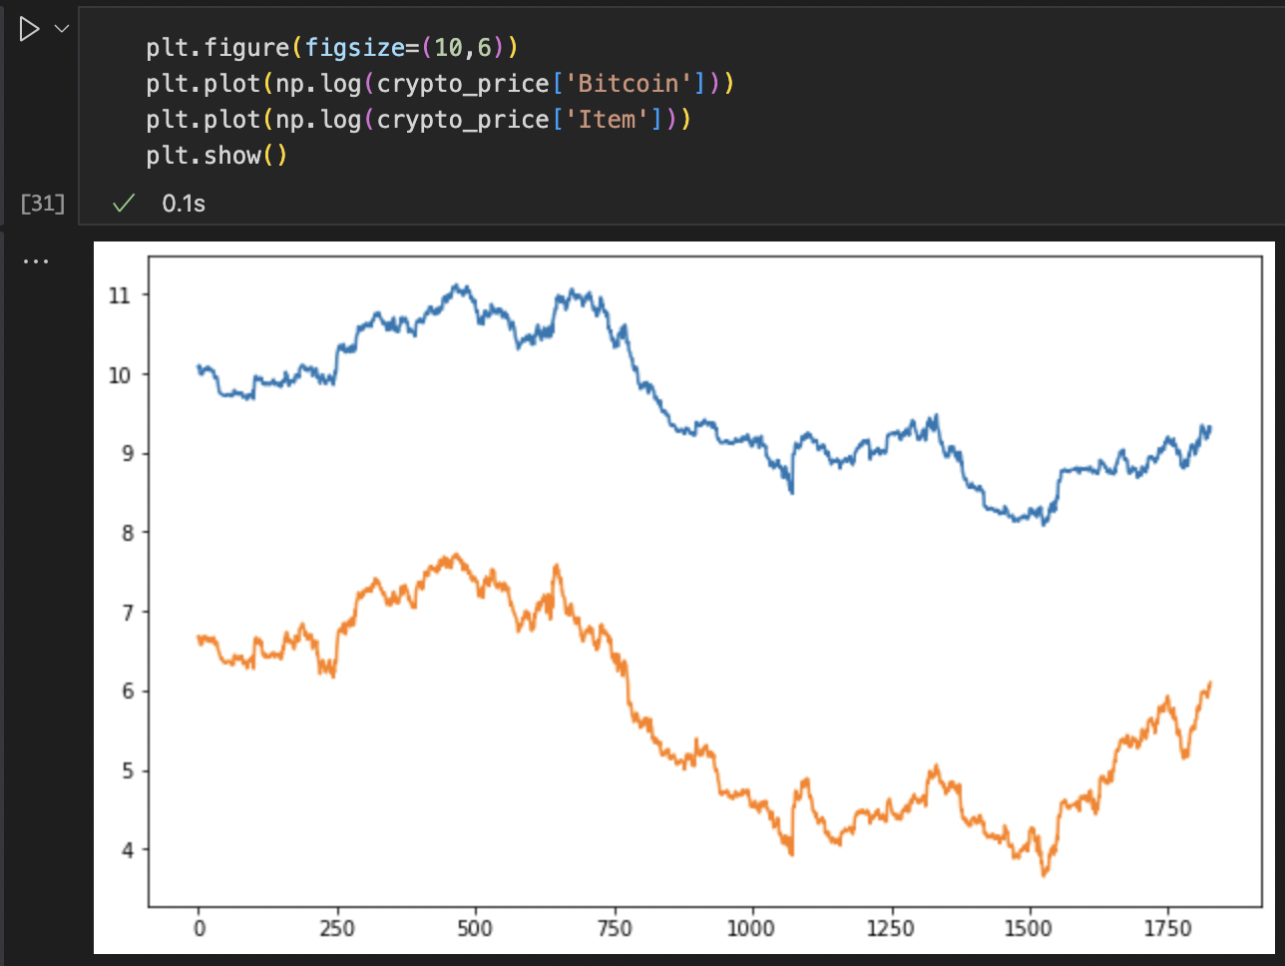
Thus, we can check that
the prices are also
highly correlated!

